Slide 1
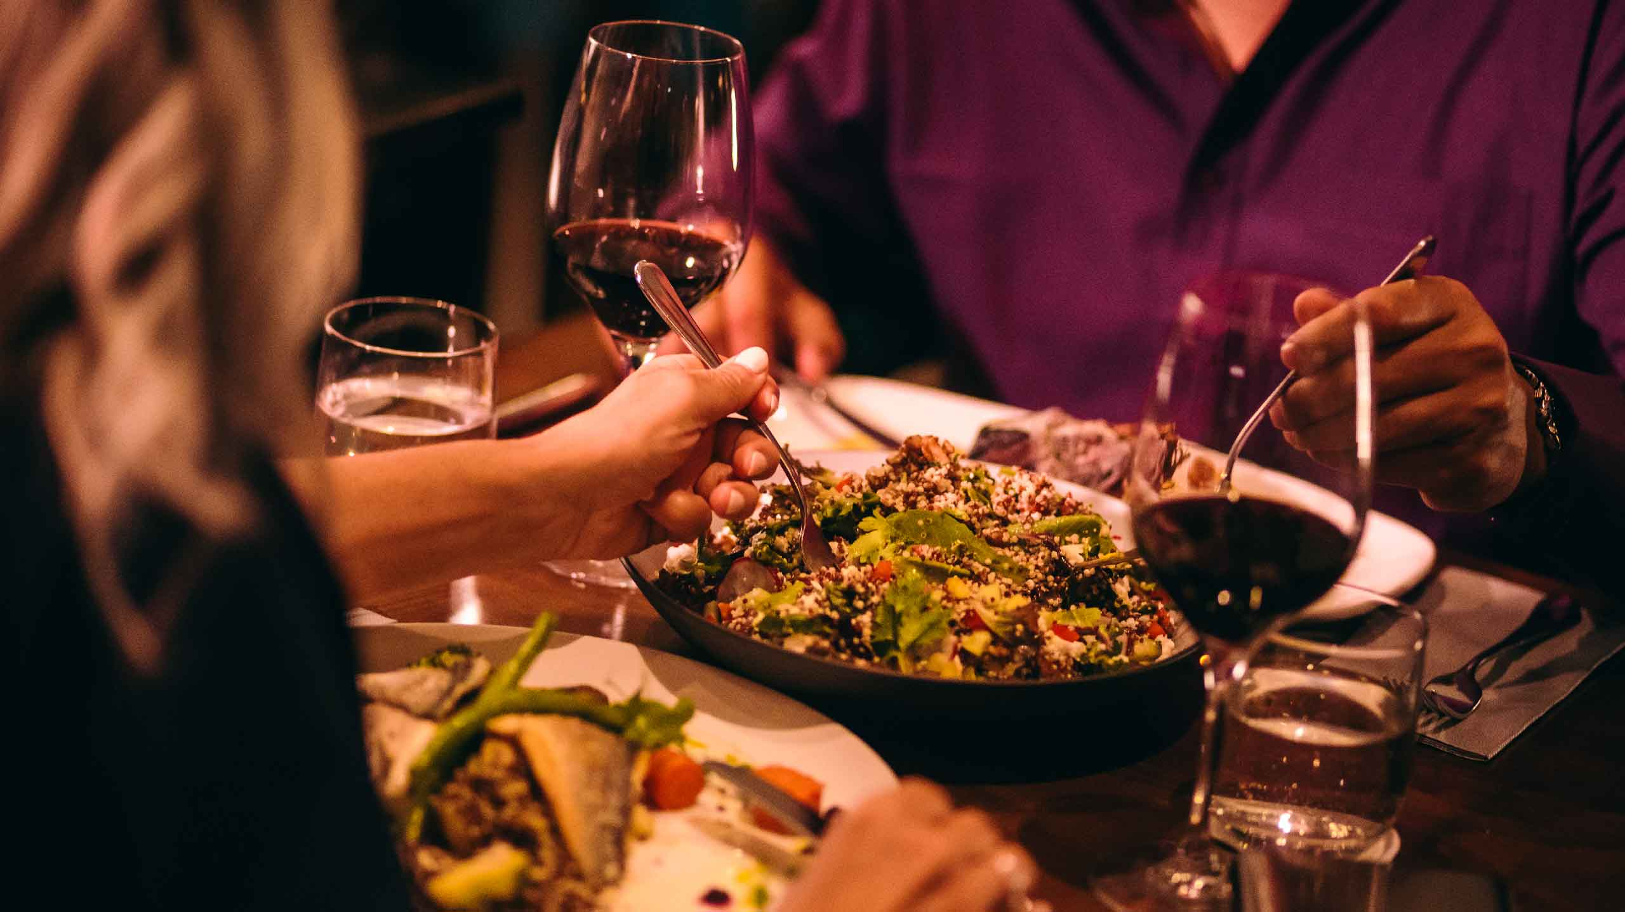
Consumer Insights Analysis for Food and Beverage Industry
MEGHNA GHOSH
DATA ANALYST INTERN
MENTORNESS

Slide 2

Agenda
Overview of the survey data
Key findings
Brand perception analysis
Consumer preferences
Recommendations for improvement

Slide 3
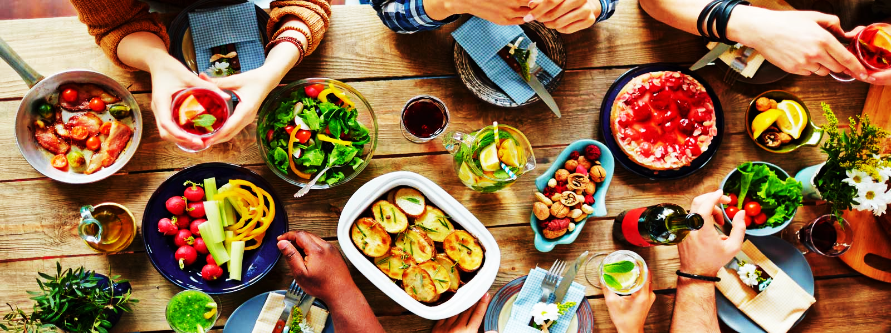
Survey Data Overview
Survey Design & Collection
Data Structure
Analysis Focus
Captured insights on consumer behavior and brand perception.
Targeted diverse demographics across cities and tiers.
Sample Size: 10,000. Mode: Online/Offline.
Fact_Survey_Responses: Core survey data (e.g., consumption frequency).
Dim_cities: City and tier information.Dim_respondents:
Demographics (age, gender, city).
Identified key trends, consumer preferences, and brand perceptions.
Analyzed across age, gender, and city tiers.

Slide 4
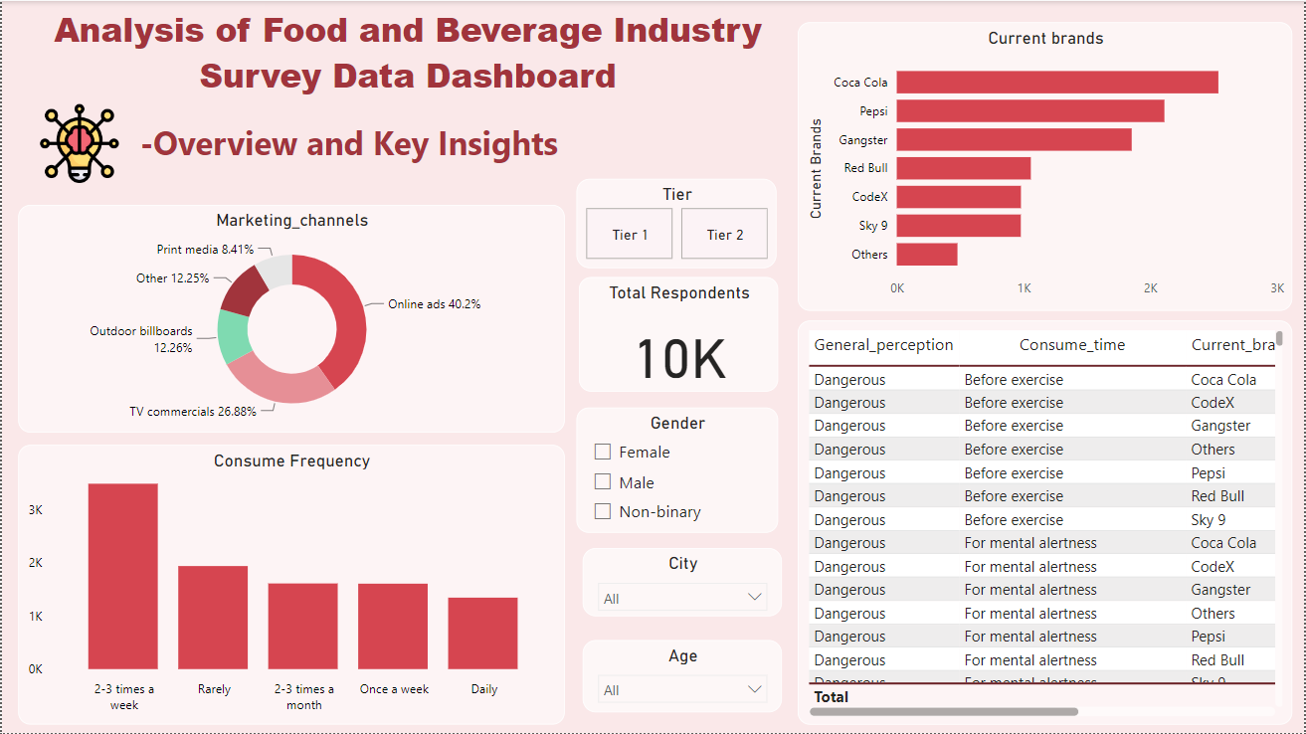
Brand Insights
Male (6.03K), Female (3.45K), Non-Binary (507).
Males aged 19-30 show the highest consumption frequency.
Top marketing channels: Online ads (40.2%) and TV commercials (26.88%).
Coca-Cola and Pepsi are the most consumed brands.
Coca-Cola has the strongest positive brand perception.

Slide 5
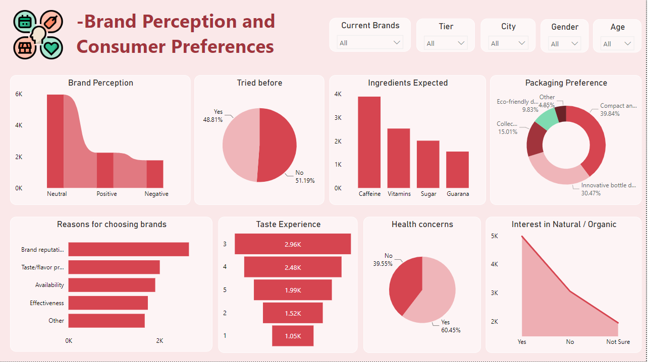
Brand Perception and Consumer Preferences

Slide 6
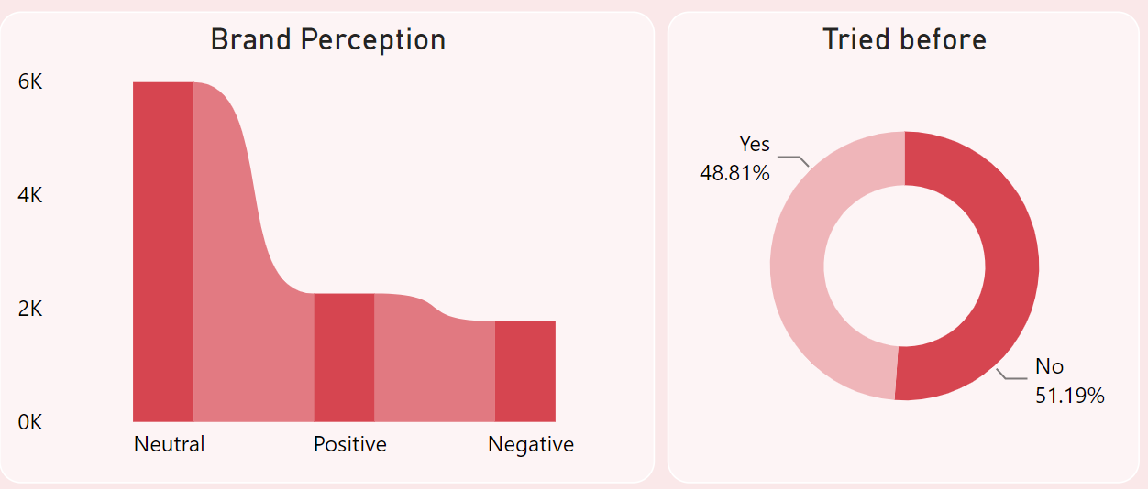
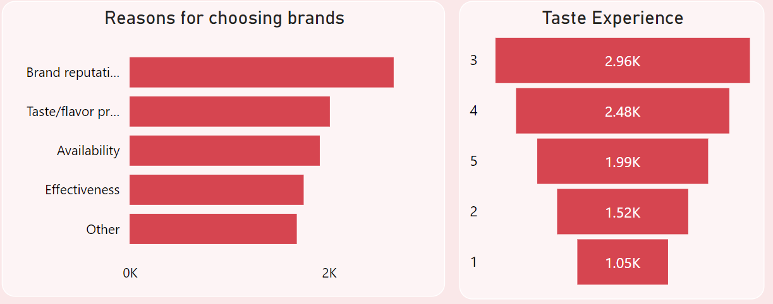
Perception about brands in the food and beverage industry is mostly neutral.
Over half of the respondents have previously tried Red Bull.
Most people choose brands according to its brand reputation among other reasons.
Most people have rated 3 followed by 4 out of 5 stars while rating their experience with the taste of the product.
Notes:
Over half of the respondents have previously tried Red Bull, making it the most commonly experienced brand among current options.

Slide 7
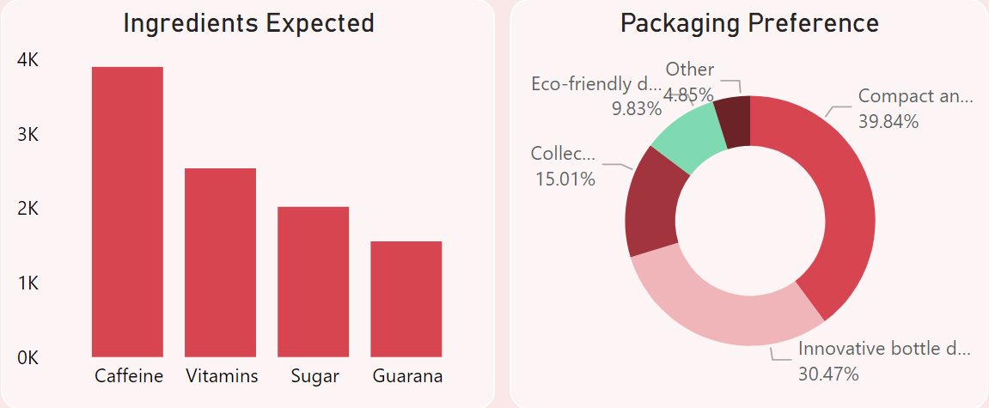
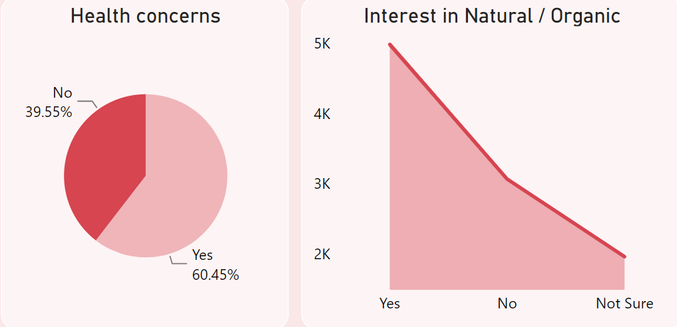
Caffeine is the most expected ingredient in the products.
Most people prefer compact and portable cans followed by innovative bottle designs.
60.45% people have concerns about health regarding the products.
Most people are interested in natural and organic products.
Notes:
Over half of the respondents have previously tried Red Bull, making it the most commonly experienced brand among current options.

Slide 8
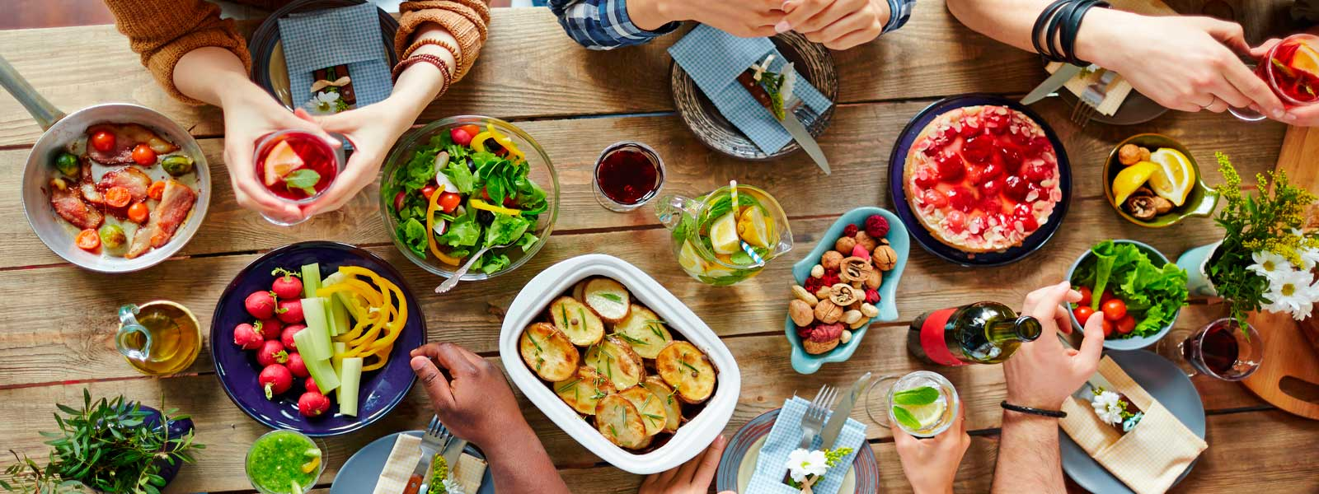
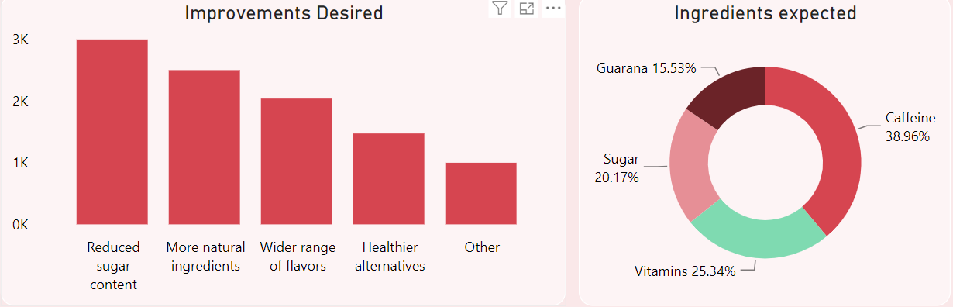
Consumer Feedback
The majority of respondents seek improvements in reducing sugar content, followed by a strong preference for more natural ingredients, a wider range of flavors, and healthier alternatives.

Slide 9
Consumer Feedback
The majority of respondents expect caffeine in their ingredients, followed by a preference for vitamins, sugar, and guarana.

Slide 10
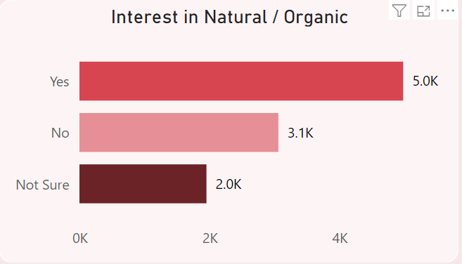
Consumer Feedback
The majority of people are interested in natural and organic products, indicating a strong consumer shift towards healthier and more sustainable choices.

Slide 11
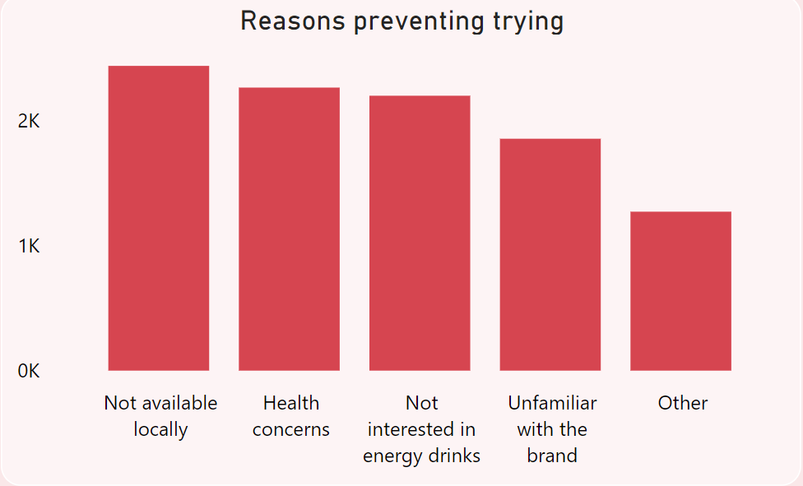
Consumer Feedback
The majority of people prevent trying these brands since they are not available locally, followed by health concerns, disinterest in energy drinks, unfamiliarity with the brand and others.

Slide 12
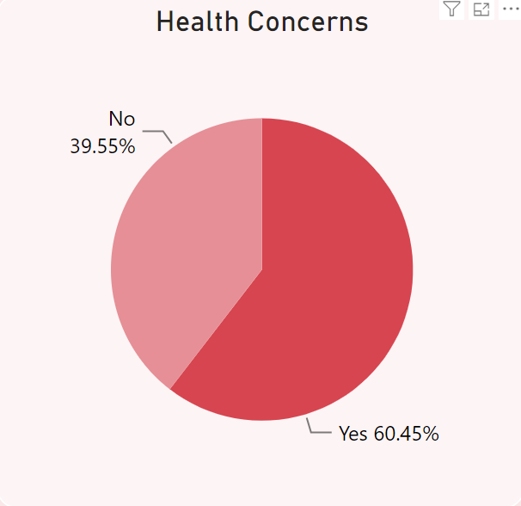
Consumer Feedback
60.65% of respondents have health concerns related to brands in the food and beverage industry.

Slide 13
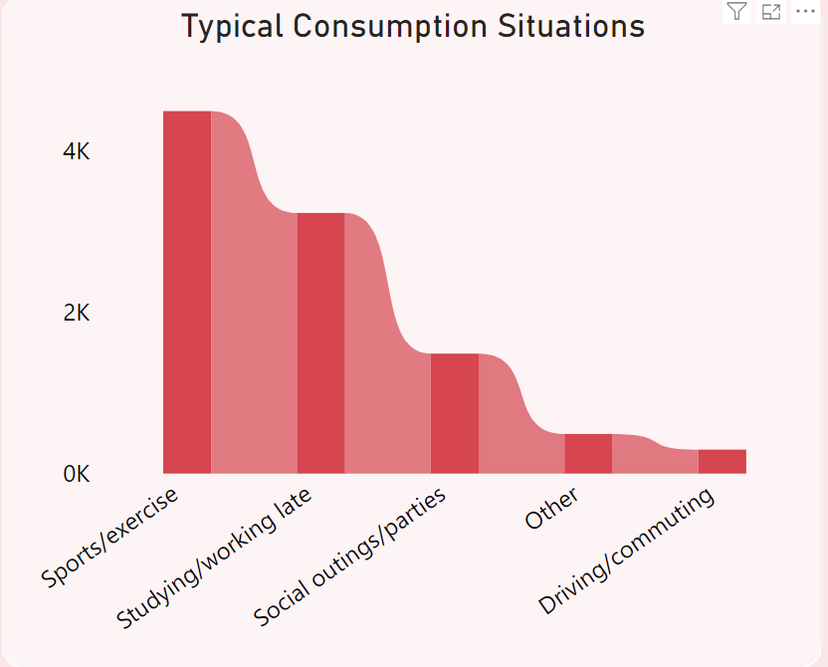
Consumer Feedback
The majority of respondents consume these products during sports or exercise, followed by studying or working late, social outings or parties, other activities, and driving or commuting.

Slide 14
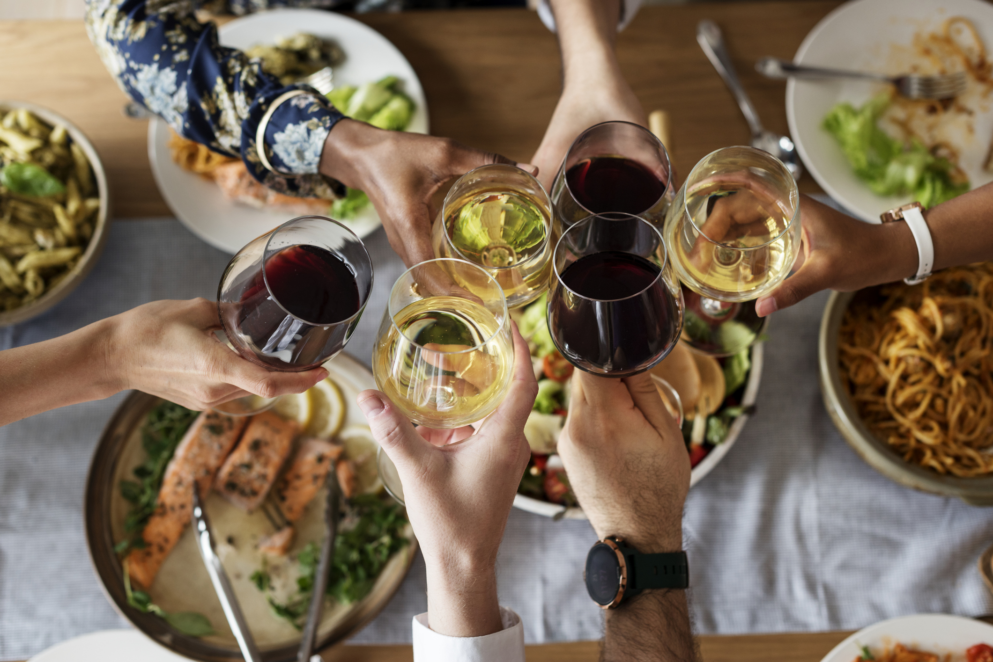
Recommendations
Healthier Products: Reduce sugar, add natural ingredients.
More Flavors: Cater to diverse preferences.
Better Availability: Expand local market presence.
Targeted Marketing: Highlight health benefits via online ads and TV.
Boost Brand Awareness: Educate consumers in low-awareness areas.
Sustainability: Focus on natural and organic offerings.
Strategic Positioning: Target sports, exercise, and late-night consumption.

Slide 15

Thank you

